Slide 1


Percival Lucena IBM Research
Blockchain Technology Details
© 2016 IBM Corporation
Page
24
Notes:
Blockchain is a new-style distributed-database technology that enables enterprises to interact more efficiently and securely
Blockchain was created for enterprise applications with a focus on privacy, confidentiality, auditability, performance and scalability.
Blockchain must be permissioned to ensure greater trust across members, while enabling more optimized forms of consensus which avoids members need to mine, which comes are great cost in compute power and performance.
Blockchain must be extensible to enable experimentation that will lead to innovations in consensus algorithms, storage, integration and performance.

Slide 2

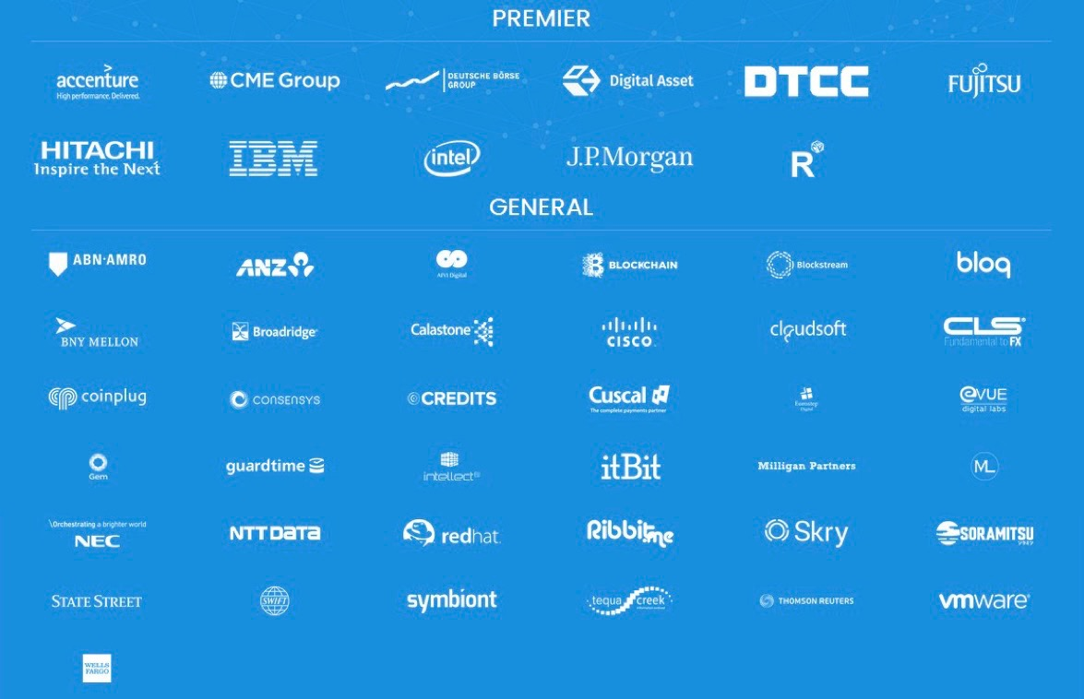


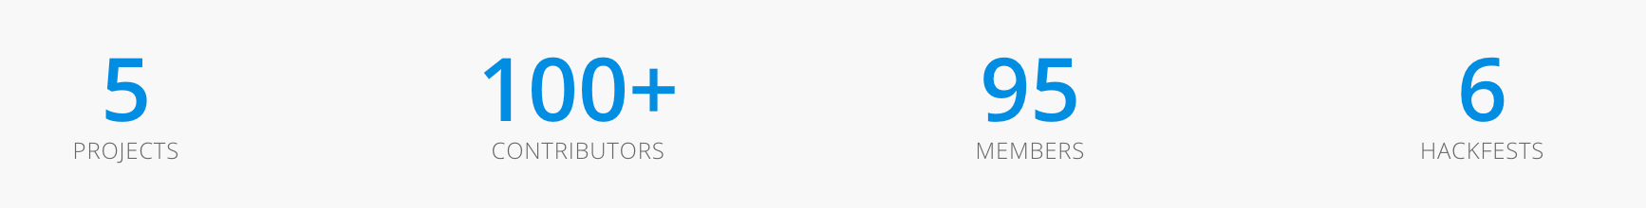
The Hyperledger Project
Open Source Open Standard Open Governance
Fabric
R3 corda
Sawtooth Lake
Brian_Behlendorf
ASF founder Executive Director
Notes:
The Linux Foundation partners with the world's leading developers and companies to solve the hardest technology problems and accelerate open technology development and commercial adoption.The Linux Foundation is home to Linux creator Linus Torvalds and lead maintainer Greg Kroah-Hartman and provides a neutral home where Linux kernel development can be protected and accelerated for years to come.
The Hyperledger Project is a collaborative effort created to advance blockchain technology by identifying and addressing important features for an enterprise-class, cross-industry open standard for distributed ledgers that can transform the way business transactions are conducted globally.
The Hyperledger Fabric, IBM's contribution to the Hyperledger Project, is a modular and scalable protocol architecture for creating blockchain networks

Slide 3

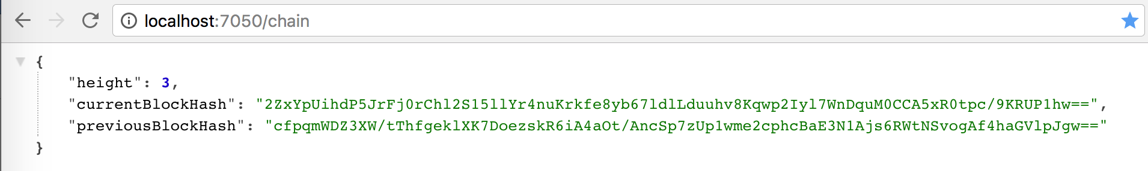
Systems Integration
Information Duplicates/Inconsitency
BLOCKCHAIN - LEDGER
Ledger
Block 13
Block 11
Block 12
Block 13
Block 12
Block 11
Proof of work:
0000005647kjp
Previous block:
000000432qrza1
Proof of work:
000000ahpoka9
Previous block:
0000005657kjp
Proof of work:
00000090b41bx
Previous block:
000000ahpoka9
Time
Transaction
lk54lfvx
Transaction
dd5g31bm
Transaction
94lxcv14
Transaction
09345w1d
Transaction
22qsx987
Transaction
abb7bxxq
Transaction
vc4232v32
Transaction
001hk009
Transaction
34oiu98a

Slide 4
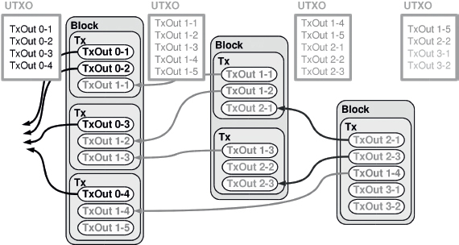
Systems Integration
Information Duplicates/Inconsitency
BLOCKCHAIN - UXTO

Slide 5
Systems Integration
Information Duplicates/Inconsitency
BLOCKCHAIN HYO- UXTO

Slide 6
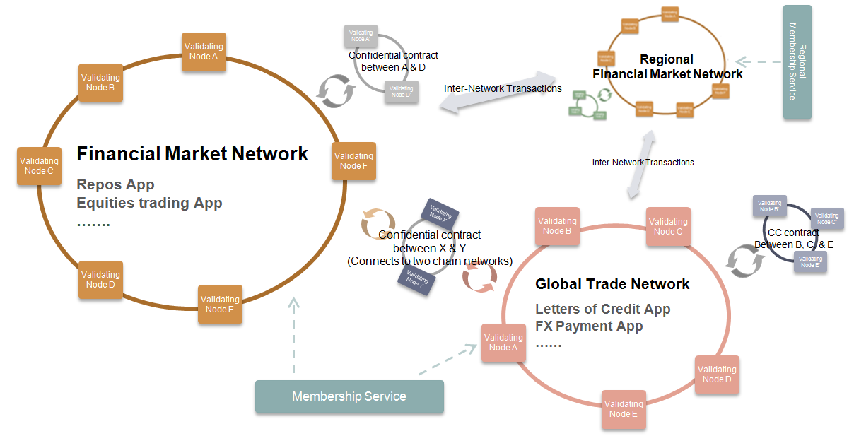
Systems Integration
Information Duplicates/Inconsitency
HYPERLEDGER – SMART CONTRACTS
NO CRIPTO CURRENCY
PERMISSIONED ACCESS
MULTIPLE NETWORKS
SMARTCONTRACTS GO/JAVA:
- GENERATE TRASACION LOGS – BLOCKS ON BLOCKCHAIN
- UPDATE STATE – UXTO
- REGISTER/CONSUME EVENTS

Slide 7
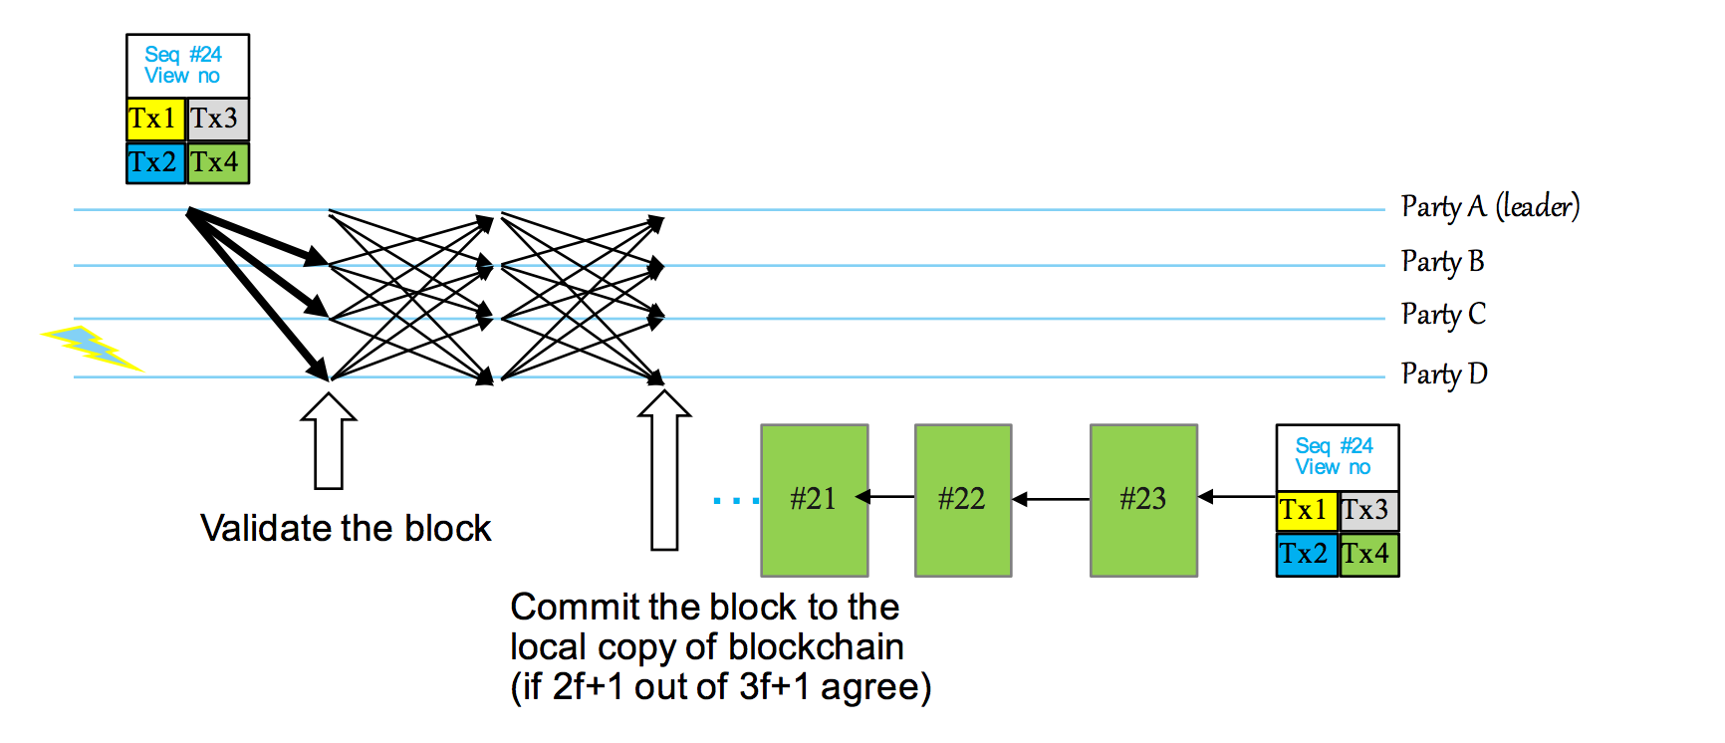

Systems Integration
Information Duplicates/Inconsitency
BLOCKCHAIN – CONSENSUS - PBFT
Transactions to be processedÇ√
Transactions already validated (and in the chain)
Node
....
Process work to validate transactions
Node
Node
Node
EXECUTE
...

Slide 8



Hyperledger Fabric
LINUX INSTALL
HYPELEDGER DOCKER
BLUEMIX SERVICE

Slide 9


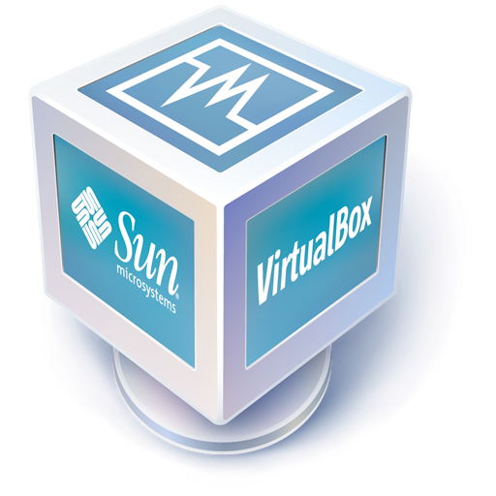

Systems Integration
Information Duplicates/Inconsitency
LINUX INSTALL – 0.61 BRANCH
1. git clone -b v0.61 http://github.com/hyperledger/fabric/
2. cd fabric/devenv
3. vagrant up
4. vagrant ssh
5. cd /hyperledger
6. make
7. peer node start --peer-chaincodedev

Slide 10
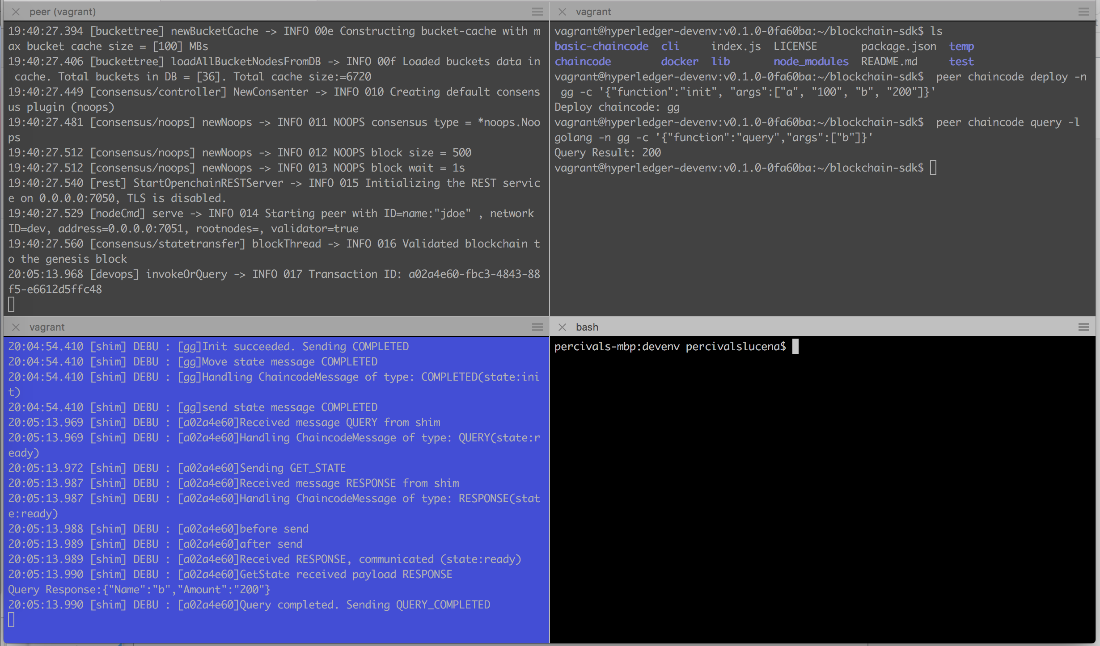
LINUX INSTALL – 0.61 BRANCH
Systems Integration
Information Duplicates/Inconsitency
Hyperledger CLI

Slide 11
Systems Integration
Information Duplicates/Inconsitency
VAGRANT CLI – 0.61 BRANCH
membersrvc (0.6.1) – controle de acesso
orderer (0.7)
peer node start --peer-chaincodedev peer chaincode deploy -l java/go -n $ContractName -c '{"Args": ["init", "arg1”, “arg2", …]}’ peer chaincode invoke -l java/go -n $ContractName -c '{"Args": [“$functionname”, "arg1”, “arg2” …”]}’ peer chaincode query -l java/go -n $ContractName -c '{"Args": ["query", "b"]}'

Slide 12
Systems Integration
Information Duplicates/Inconsitency
DOCKER INSTALL – 0.61 BRANCH
VERSION 0.6.1 WITH JAVA SUPPORT
IN CASE YOU HAVE OTHER HYPERLEGER DOCKER IMAGES, YOU SHOULD REMOVE THEM FIRST
docker pull hyperledger/fabric-peer:x86_64-0.6.1-preview
docker pull hyperledger/fabric-javaenv:x86_64-0.6.1-preview
3. docker run --name vp0 -it -e CORE_VM_ENDPOINT=unix:///var/run/docker.sock -v /var/run/docker.sock:/var/run/docker.sock -p 7050:7050 -e CORE_LOGGING_LEVEL=DEBUG -e CORE_PEER_ID=vp0 -e CORE_PEER_ADDRESSAUTODETECT=true hyperledger/fabric-javaenv:x86_64-0.6.1-preview peer node start

Slide 13
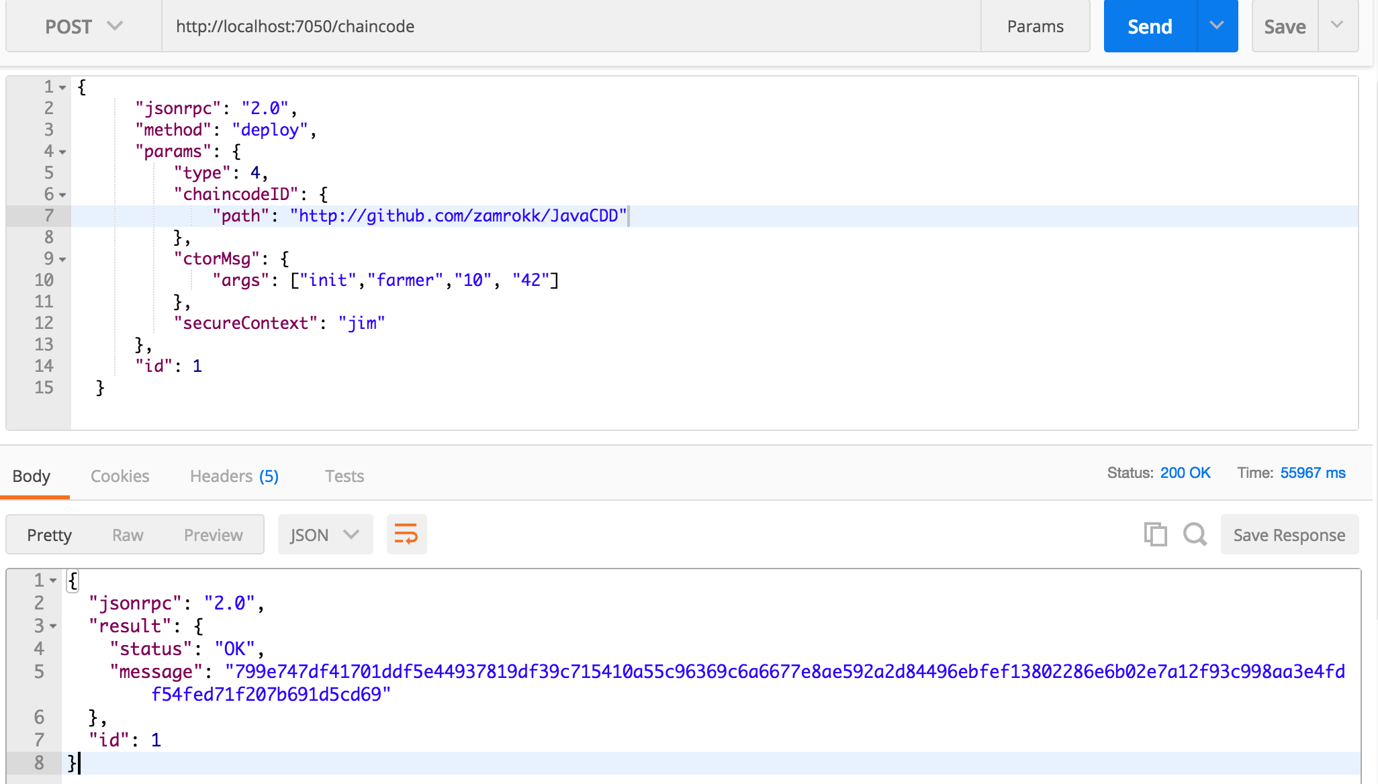
Systems Integration
Information Duplicates/Inconsitency
DOCKER REST INTERFACE– 0.61 BRANCH

Slide 14
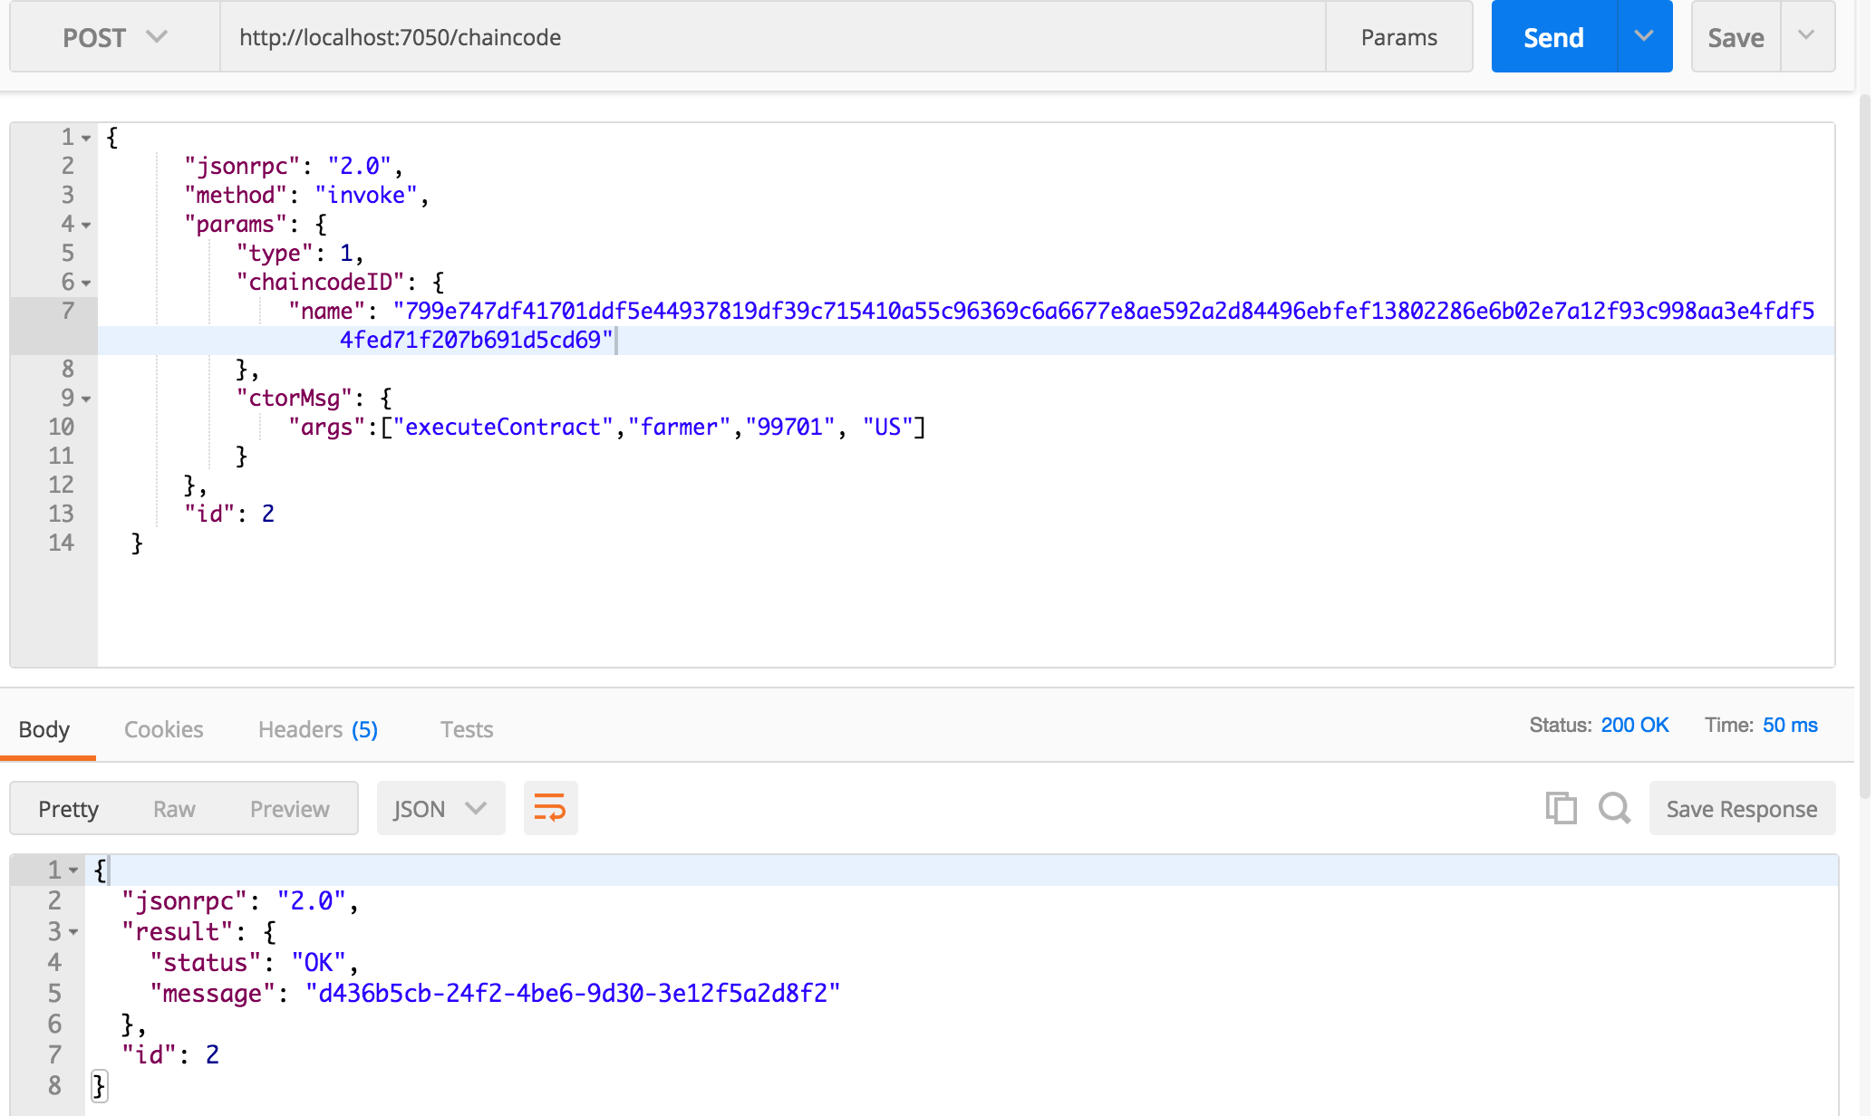
Systems Integration
Information Duplicates/Inconsitency
DOCKER REST INTERFACE– 0.61 BRANCH

Slide 15
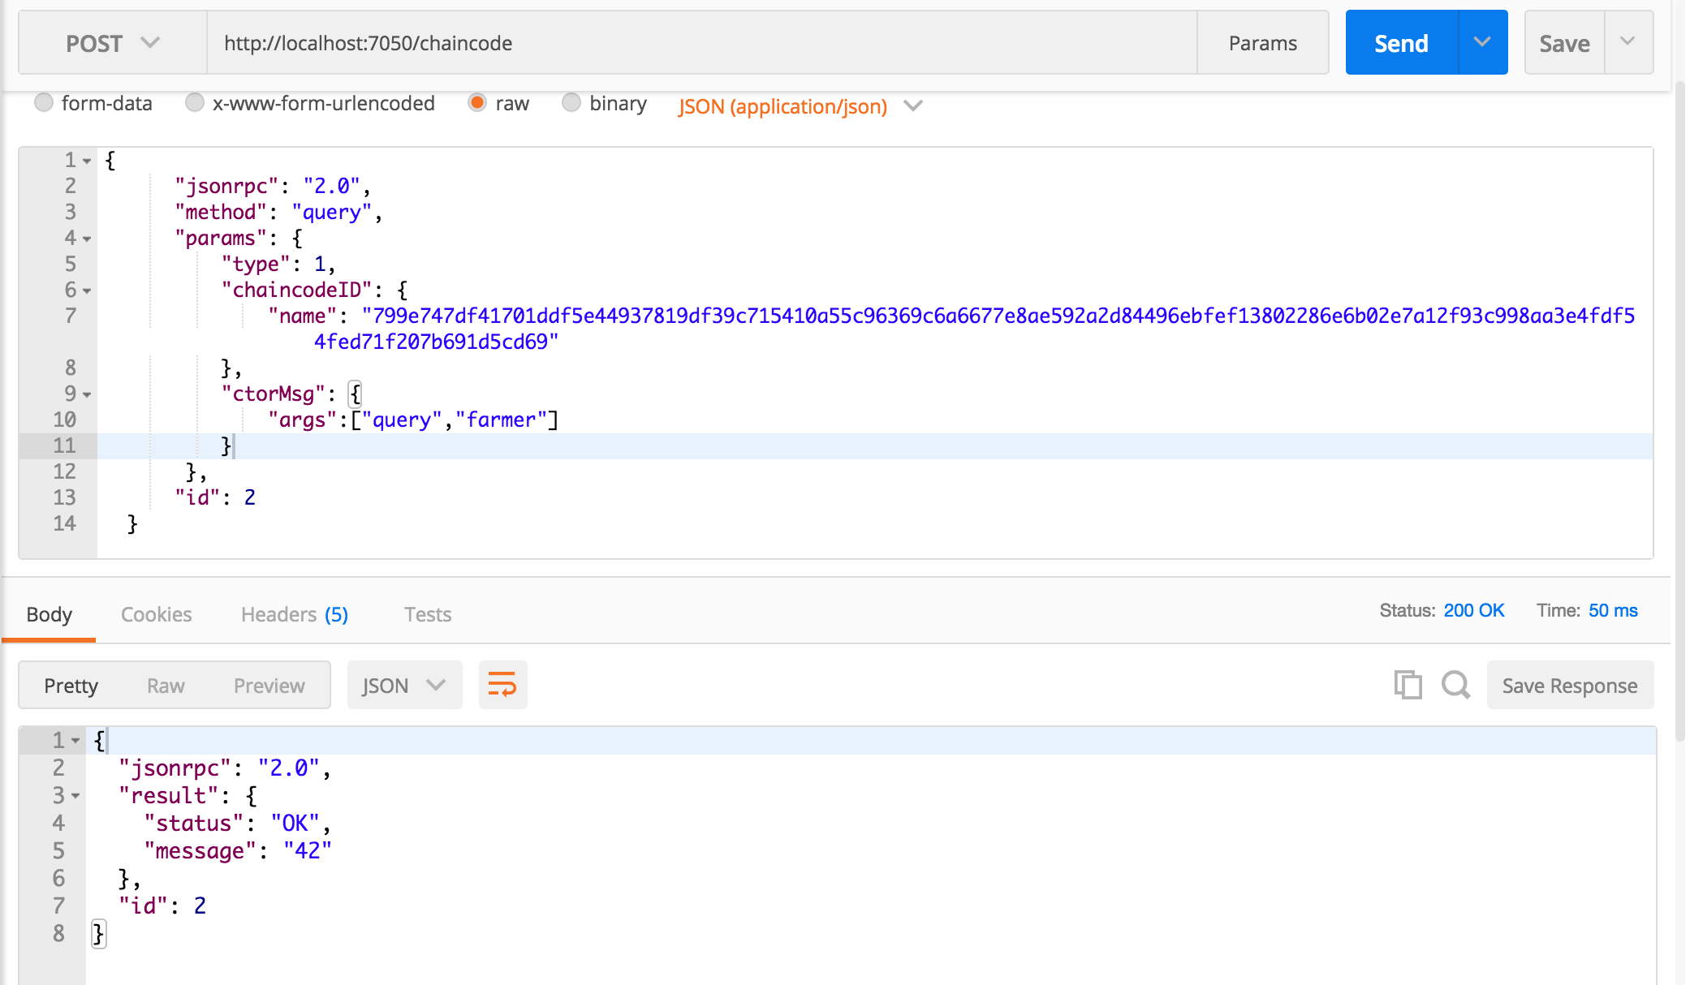
Systems Integration
Information Duplicates/Inconsitency
DOCKER REST INTERFACE– 0.61 BRANCH

Slide 16
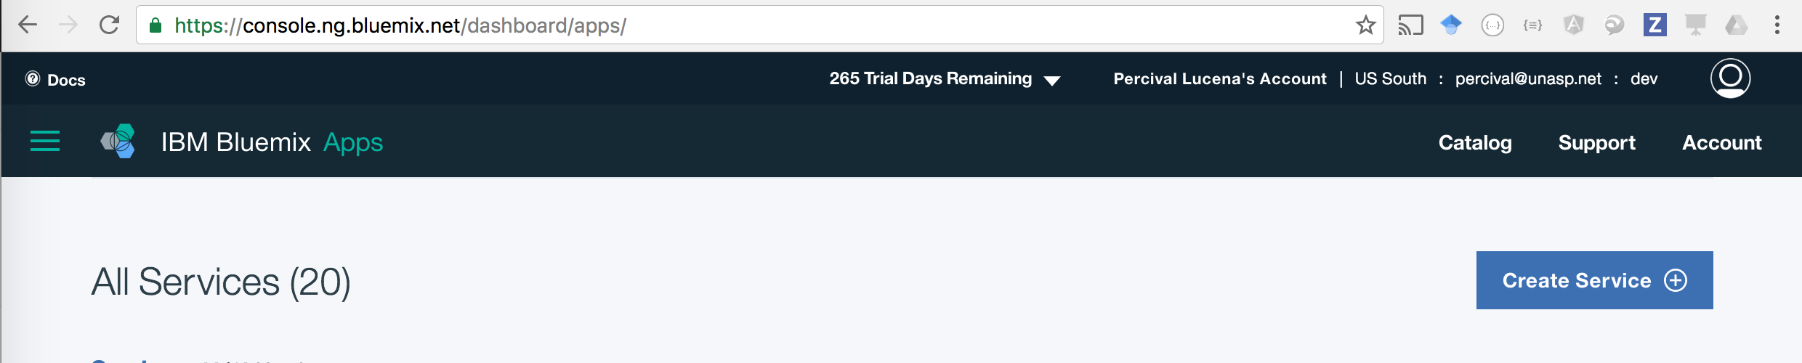
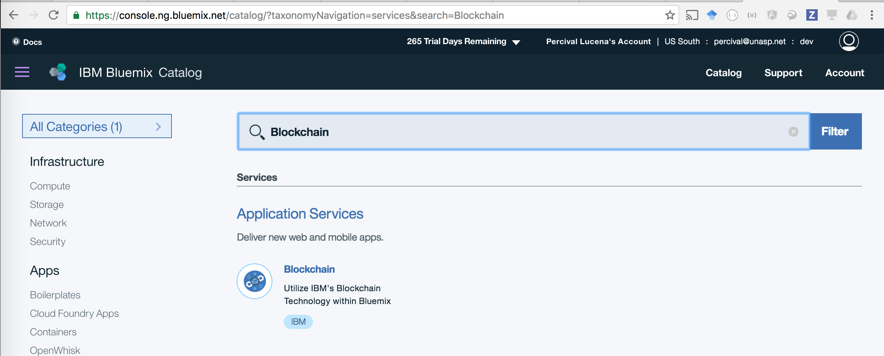
Hyperledger Service

Slide 17
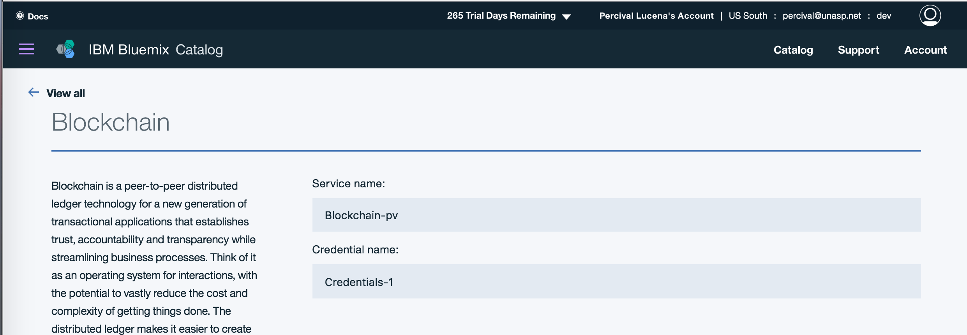
Hyperledger Service

Slide 18
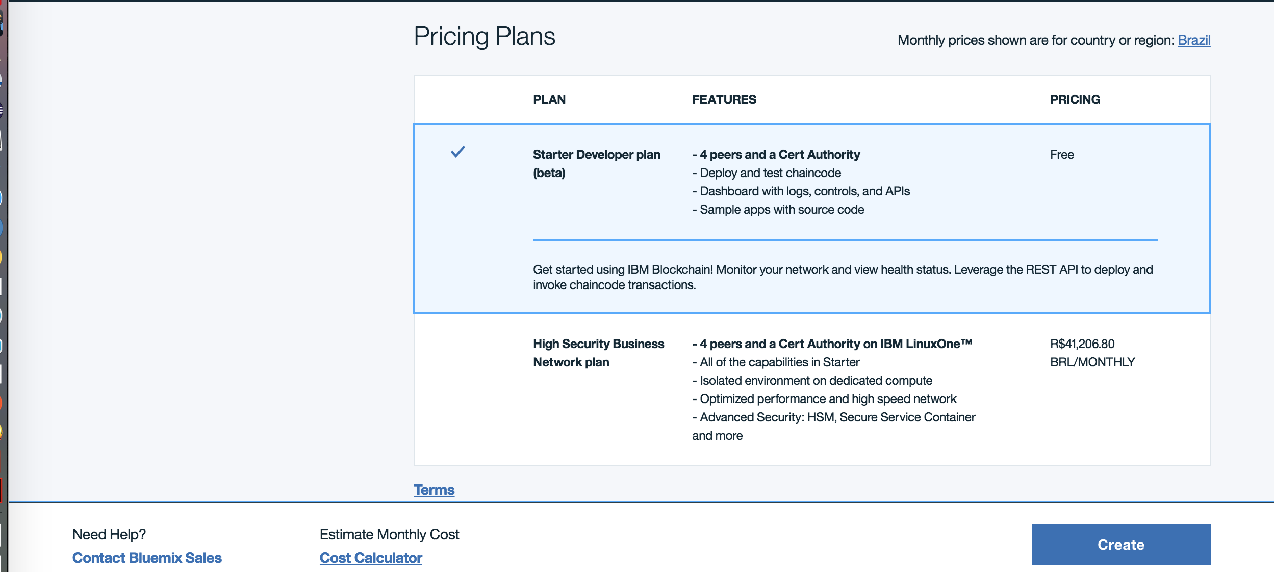
Hyperledger Service

Slide 19
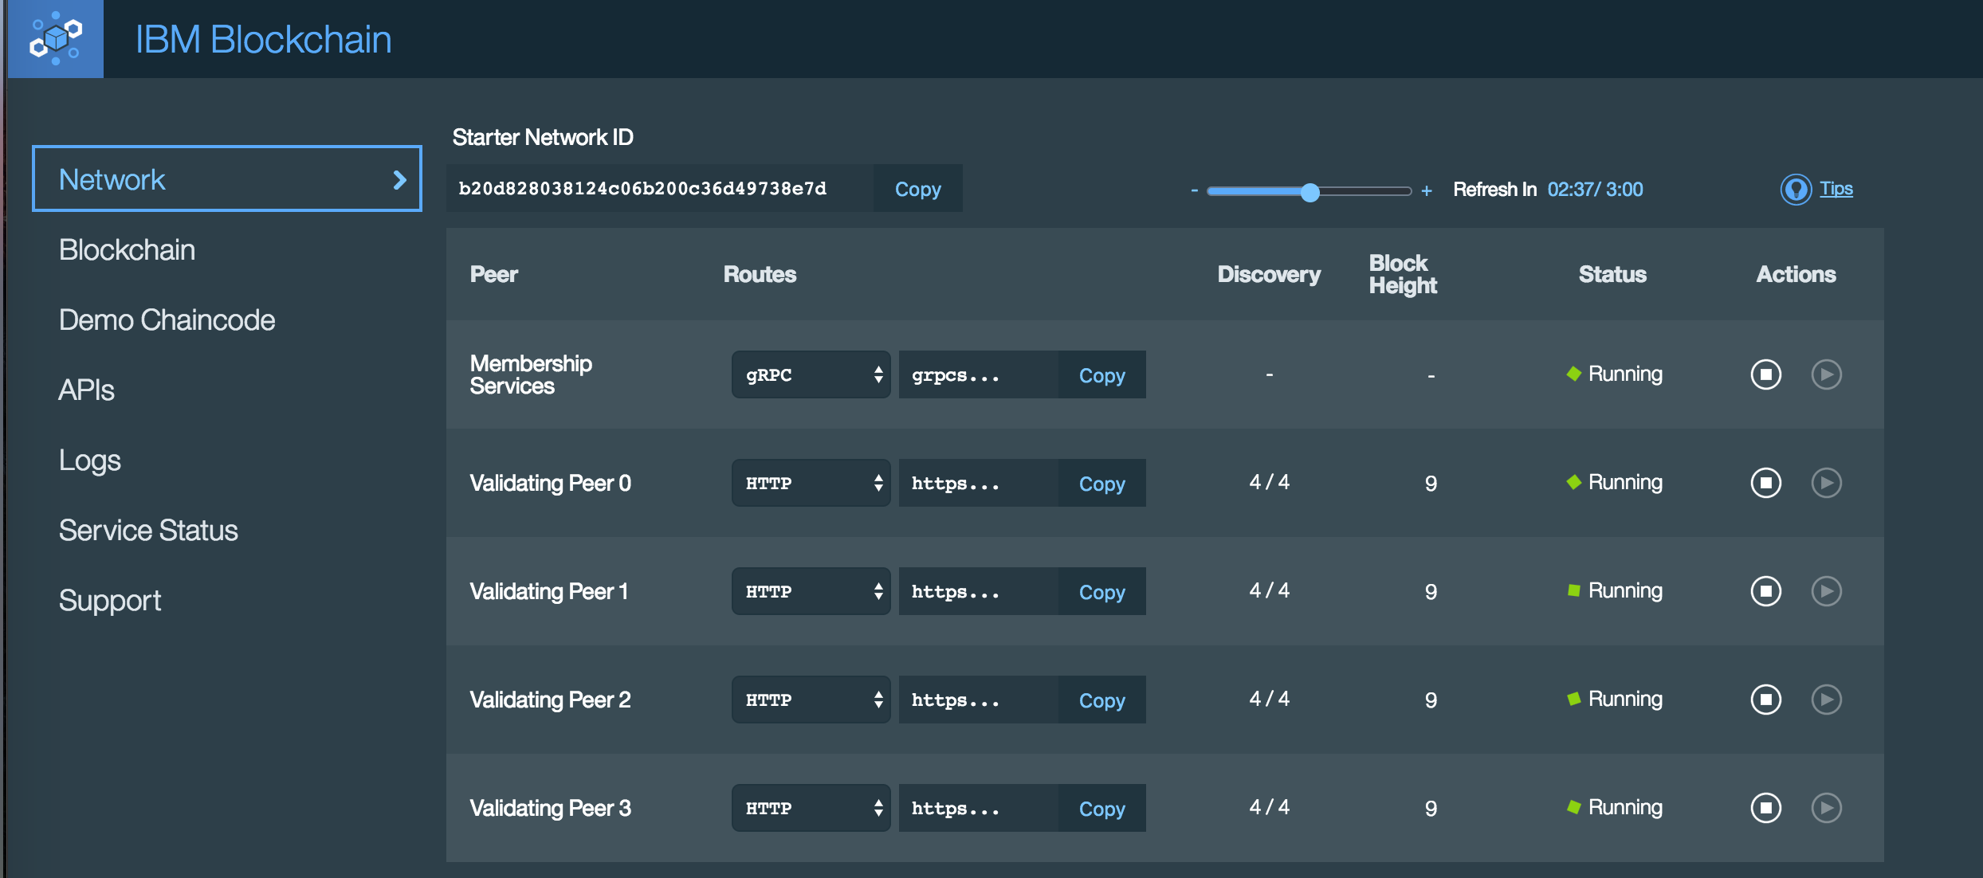
Hyperledger Service

Slide 20
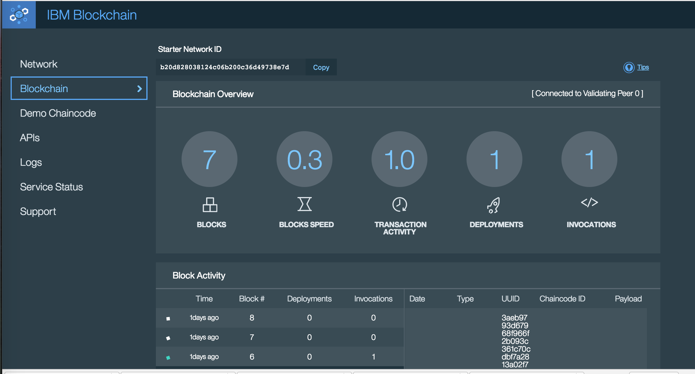
Hyperledger Service

Slide 21
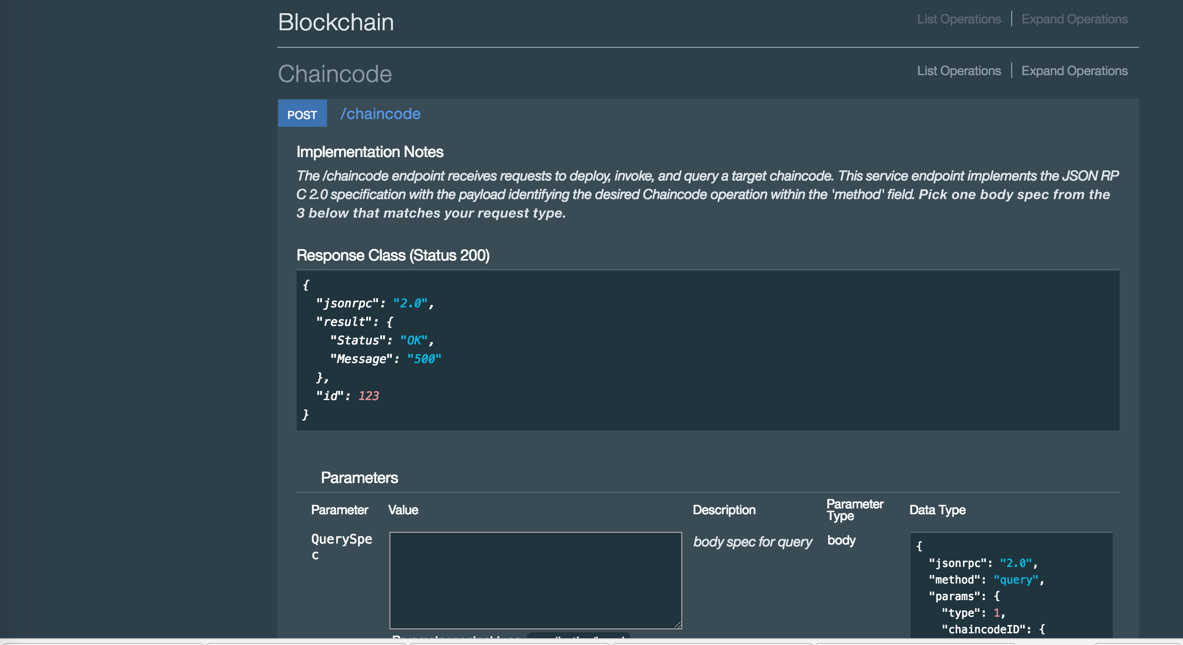
Hyperledger Service

Slide 22
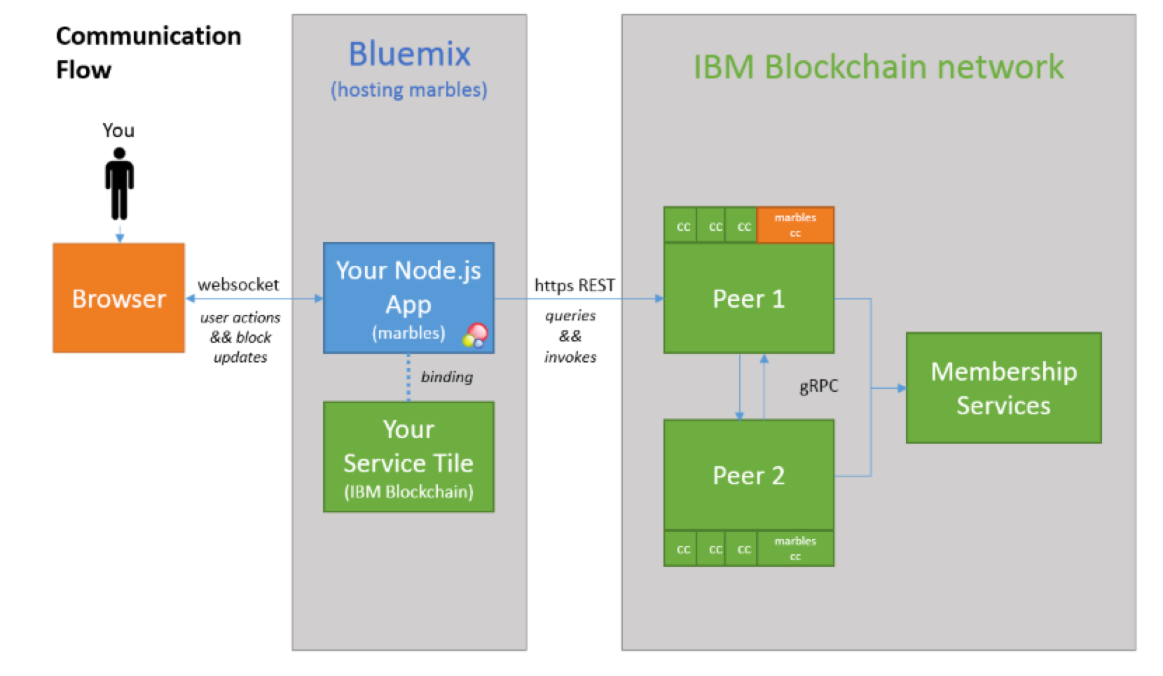
Systems Integration
Information Duplicates/Inconsitency
Hyperledger Service

Slide 23
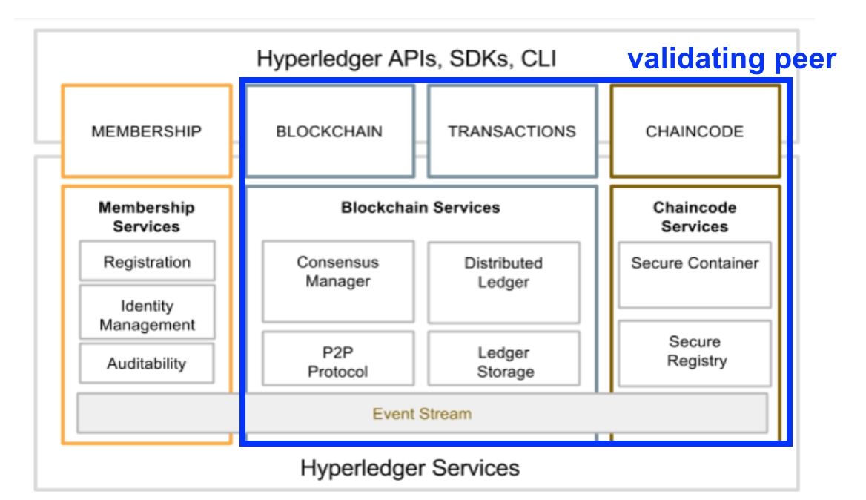

Hyperledger – Architecture 0.6
Notes:
1. Membership Service - Register Users who have access to invoke (execute), query, deploy smart contracts on blockchain on validating peers 2. Blockchain network is usually composed of a Membership services and a set (usually 4 or more validating peers)
3. Consensus Manager - PBFT, SimpleBFT, pluggable Proof of Stake
4. P2P Protocol - GRPC
5. Ledger Storage - Key-pair - world state - RocksDB
6. Secure Container - Execute GO Smart Contracts

Slide 24
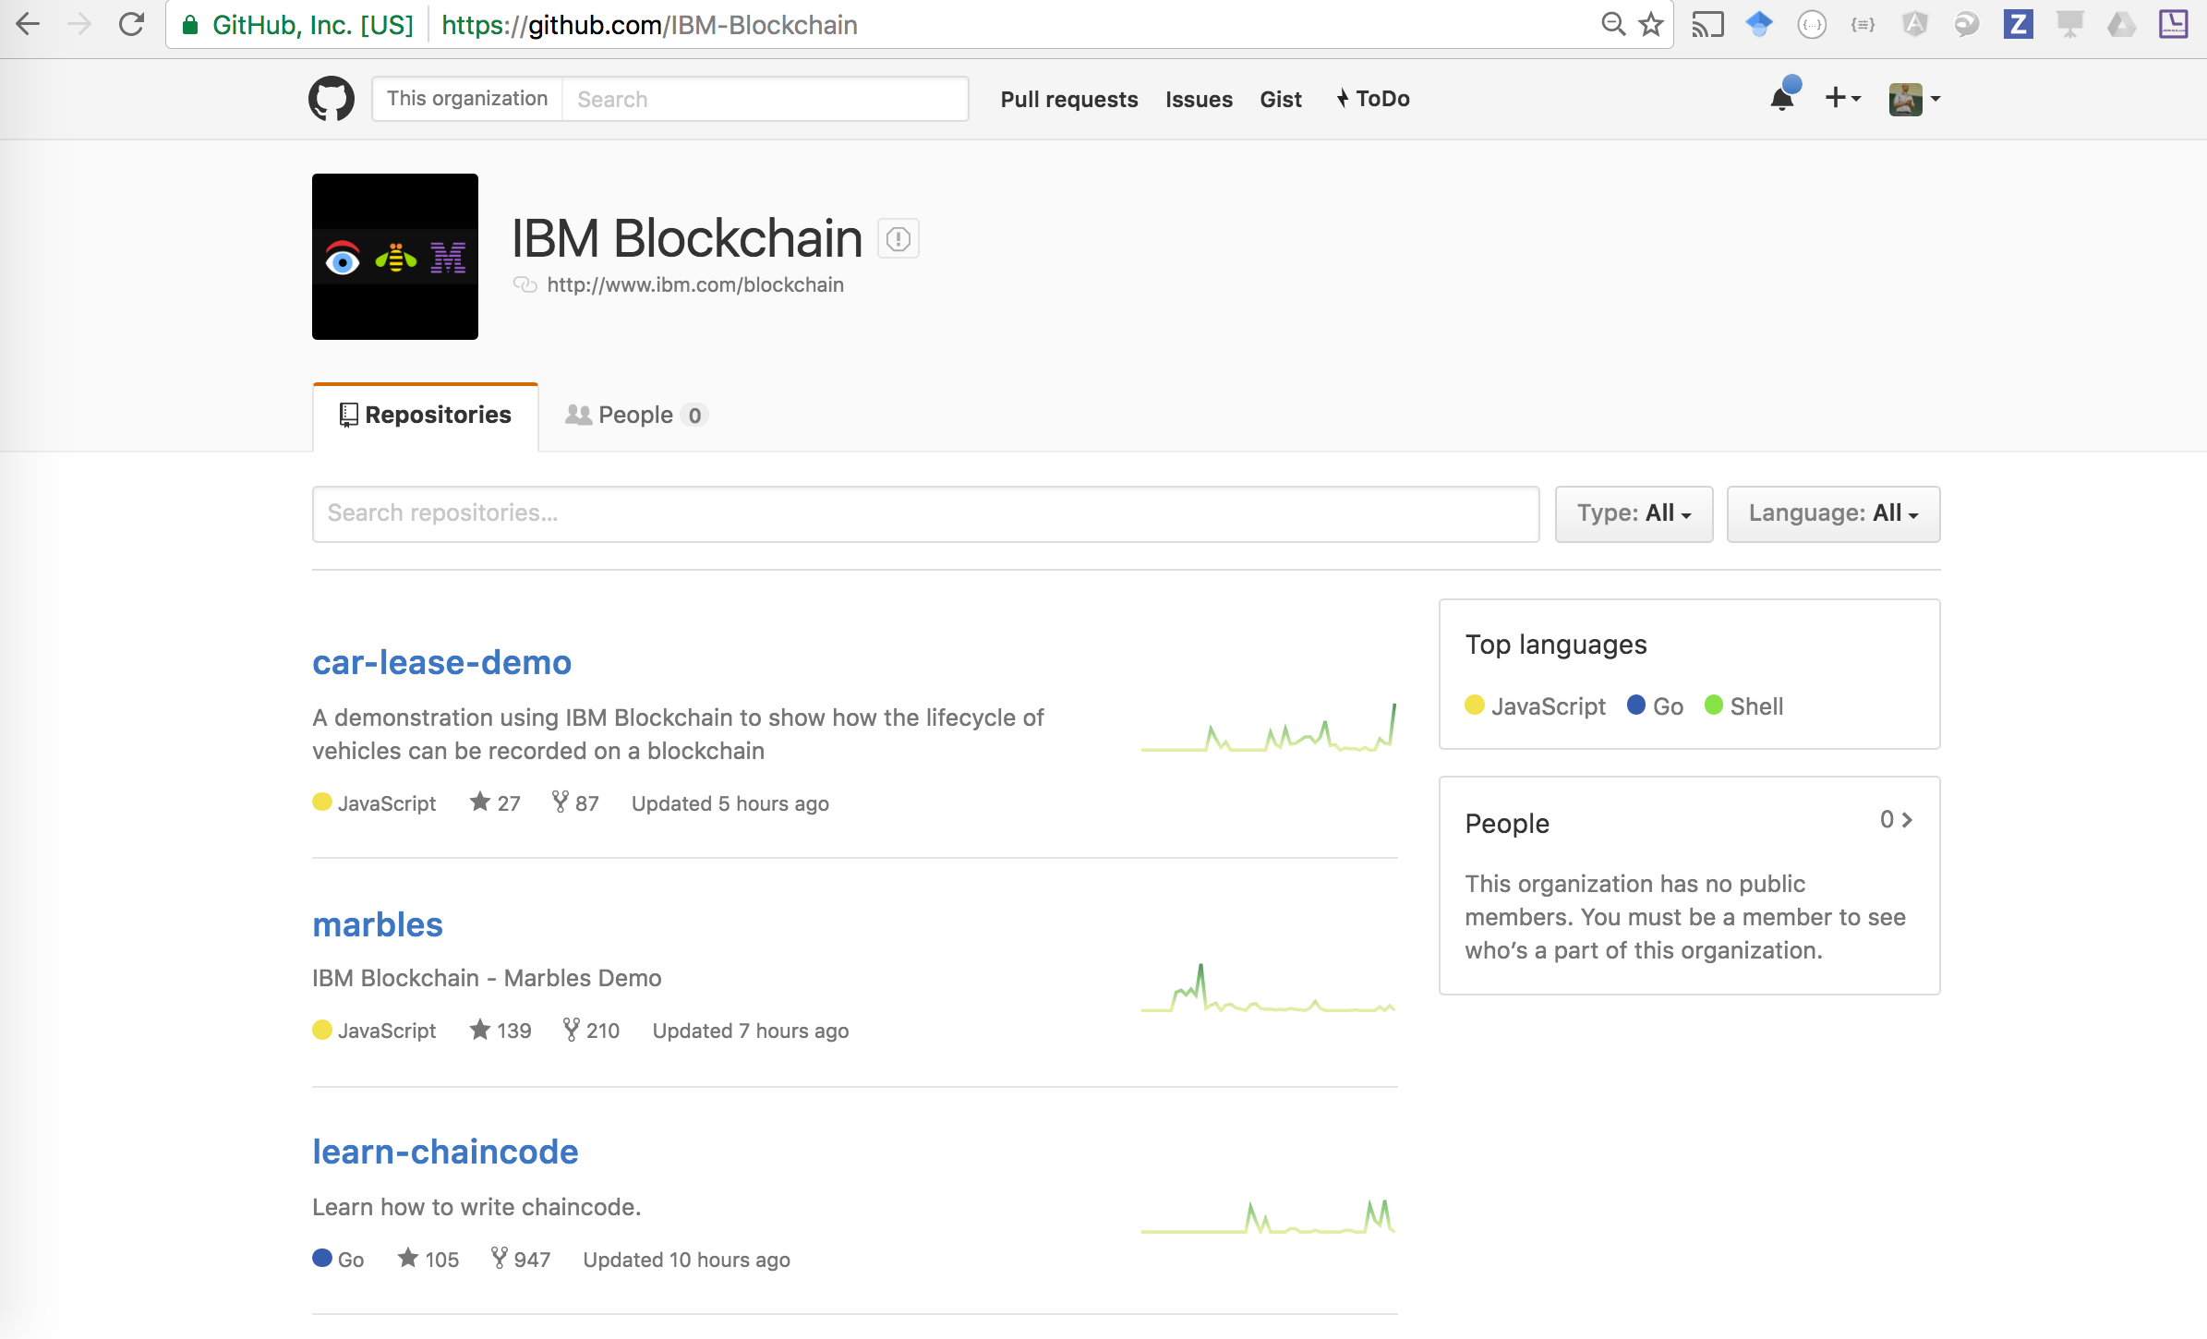
Systems Integration
Information Duplicates/Inconsitency
Where do I start? —-> SAMPLE APPS

Slide 25
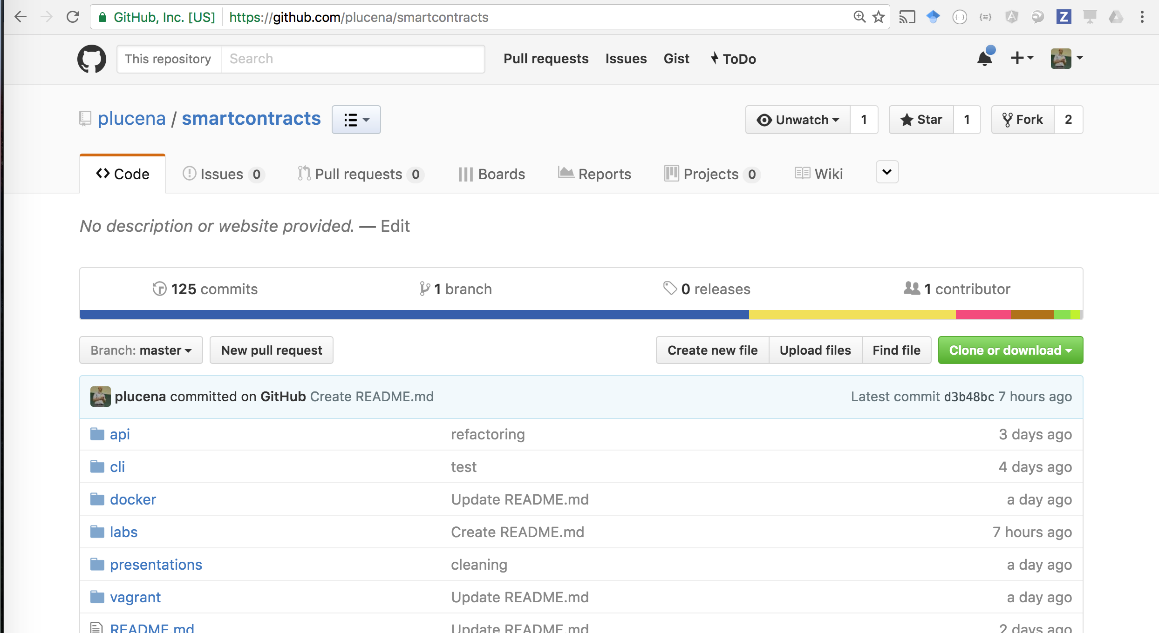
Systems Integration
Information Duplicates/Inconsitency
Where do I start? —-> TUTORIALS

Slide 26
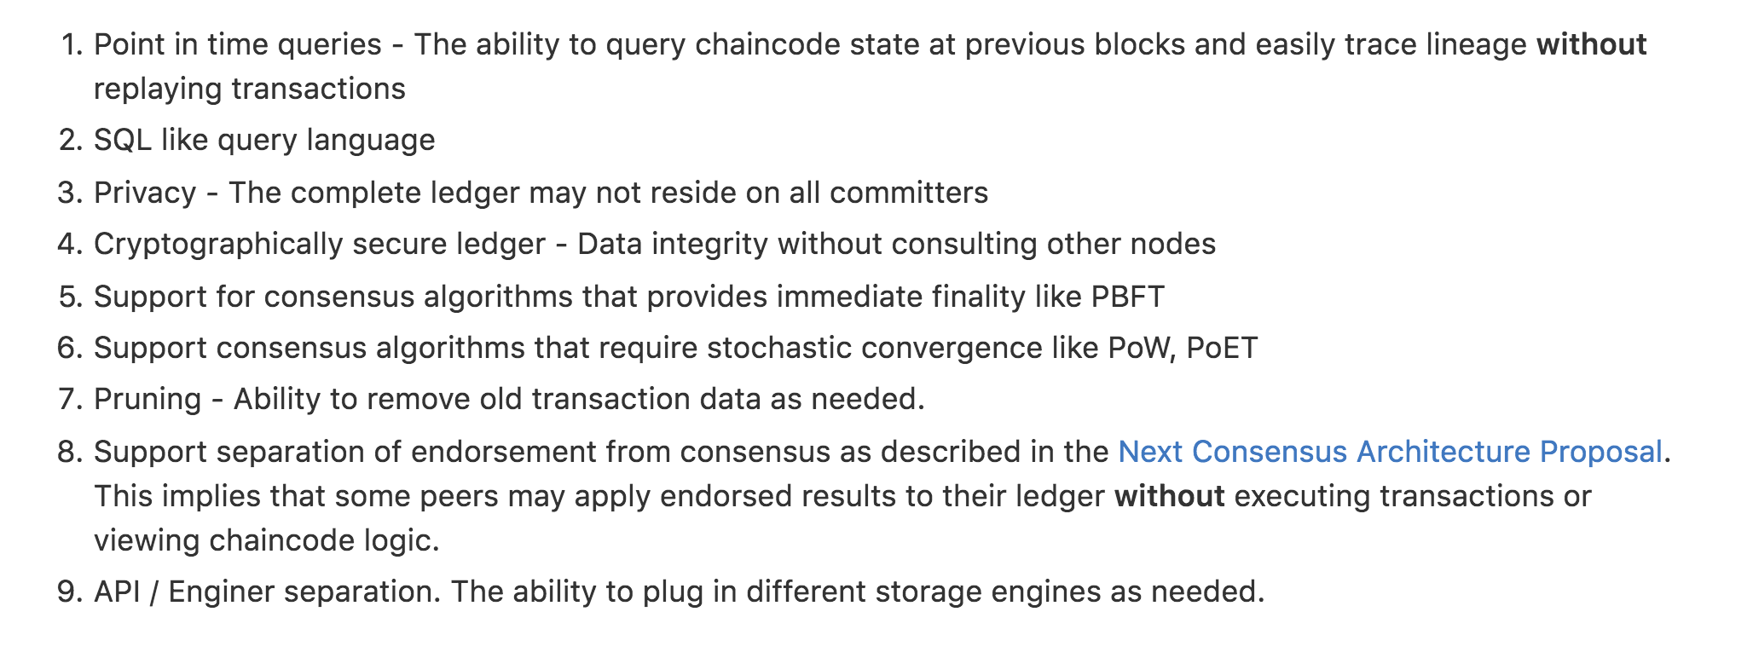
Systems Integration
Information Duplicates/Inconsitency
Hyperledger 0.7, 1.0

Slide 27
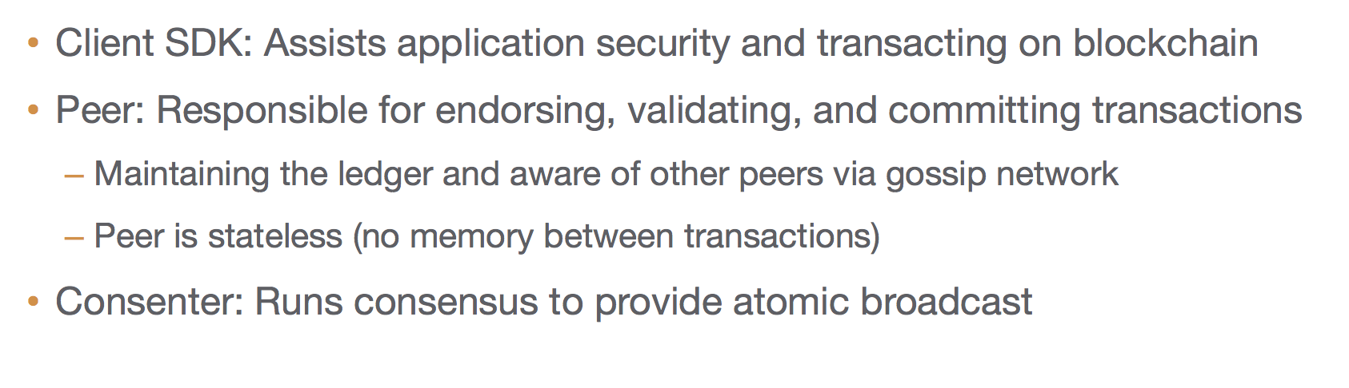
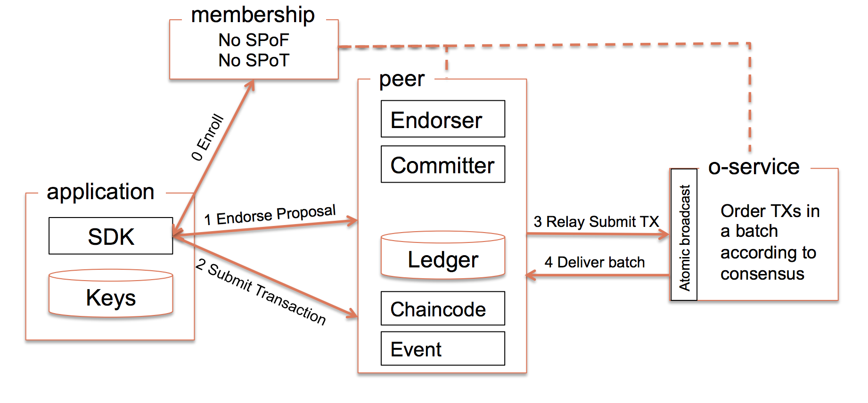
Systems Integration
Information Duplicates/Inconsitency
Hyperledger 0.7, 1.0

Slide 28
Systems Integration
Information Duplicates/Inconsitency
LINKS
REST
https://github.com/plucena/blockchain-sdk GRPC - npm install hfc —save
https://github.com/hyperledger/fabric/tree/master/sdk/node IBM SAMPLE APPS - https://github.com/IBM-Blockchain
DeveloperWorks Tutorial - http://ibm.co/2bOZoMh - Java - https://github.com/xspeedcruiser/java-chaincode-tutorial

